Slide 1
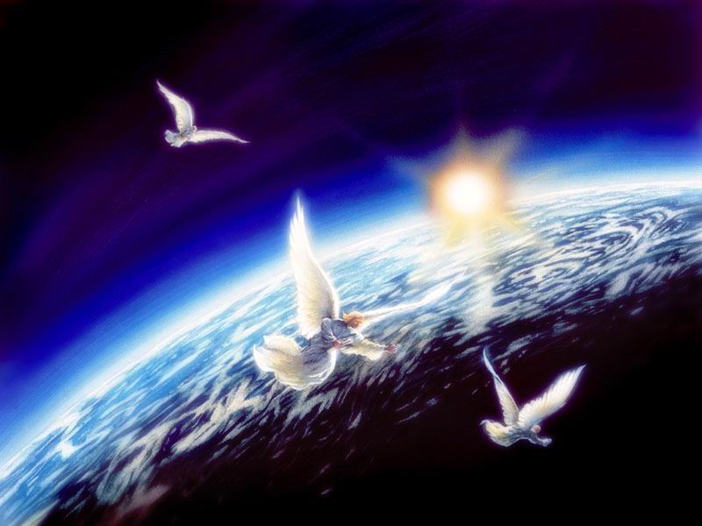
REVELATION SEMINAR
#8 Revelation’s amazing space city

Slide 2
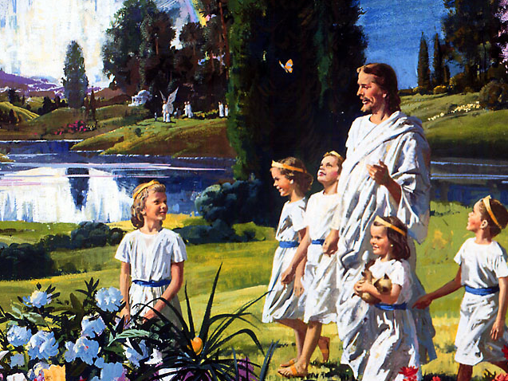

Slide 3
OUR HEAVENLY
HOME

Slide 4
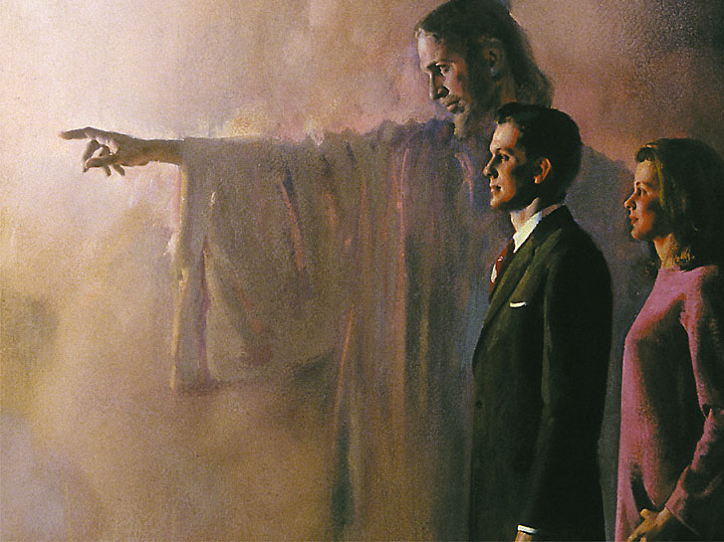
1. What has God prepared for His people?
Hebrews 11:16 (1769)

Slide 5
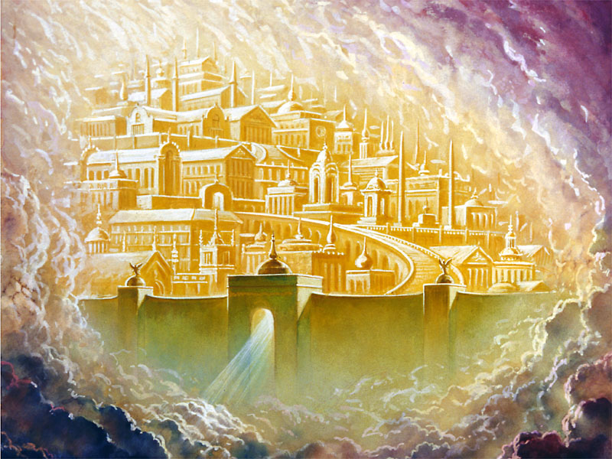
A city

Slide 6
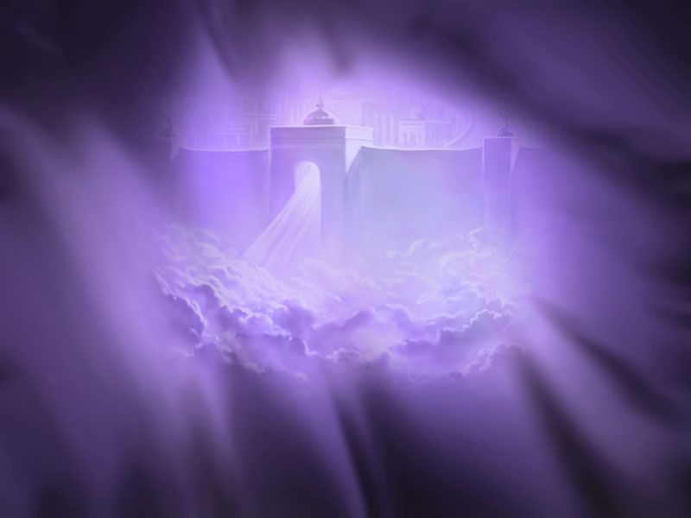
2. What is the name of the city?
Revelation 3:12 (1804)

Slide 7
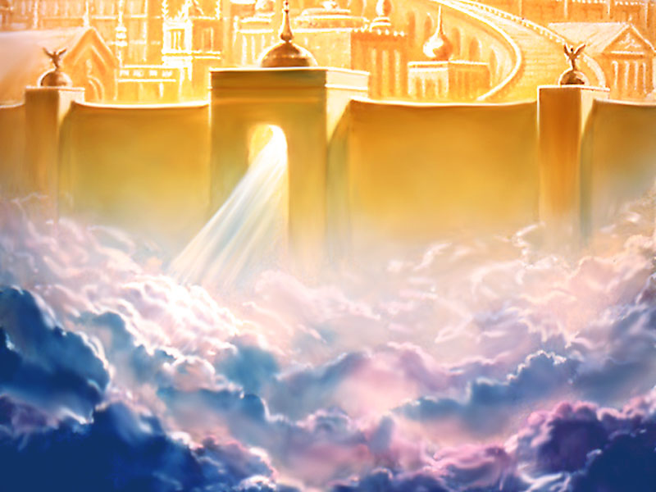
New Jerusalem

Slide 8
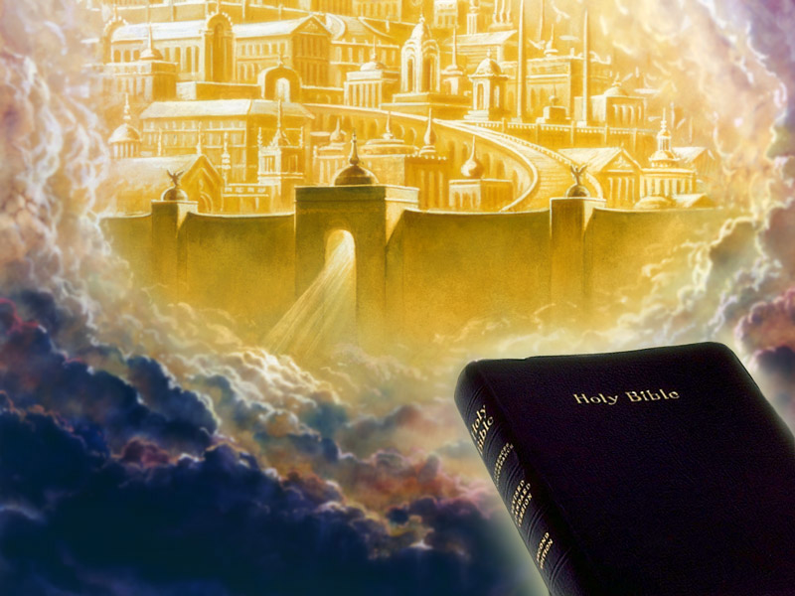
3. What happens to the New Jerusalem at the close of the 1000 years of Revelation 20 (1822)?
Revelation 21:2, 10 (1823)

Slide 9
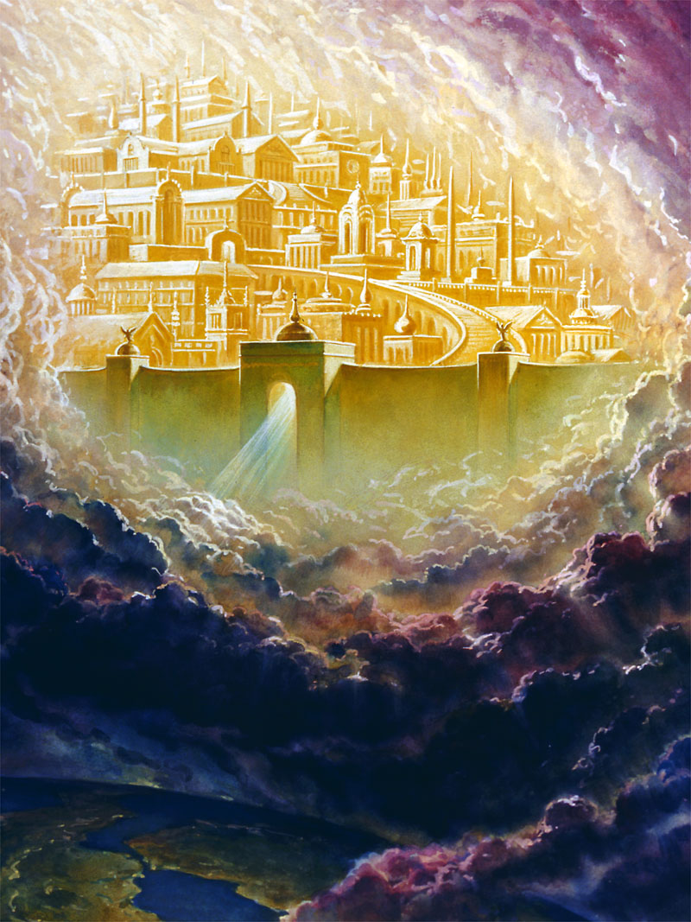
It comes down to earth.

Slide 10
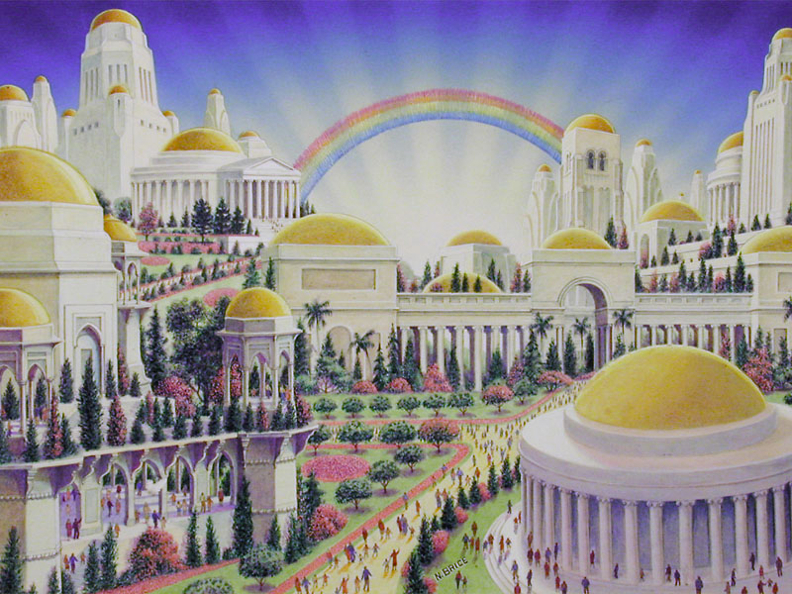
4. Where will this colossal
space city land?
Zechariah 14:1, 4, 5, 10 (1388)

Slide 11
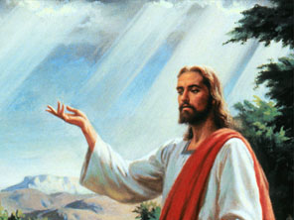
At the site of the Mount of Olives, which is before Jerusalem.

Slide 12
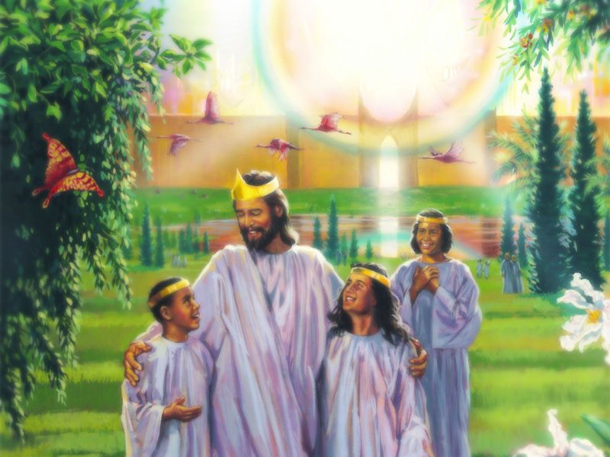
5. The city is perfectly square. What is the distance around the city?
Revelation 21:16 (1824)

Slide 13
12,000 furlongs

Slide 14
AN
ARCHITECT’S
DREAM

Slide 15
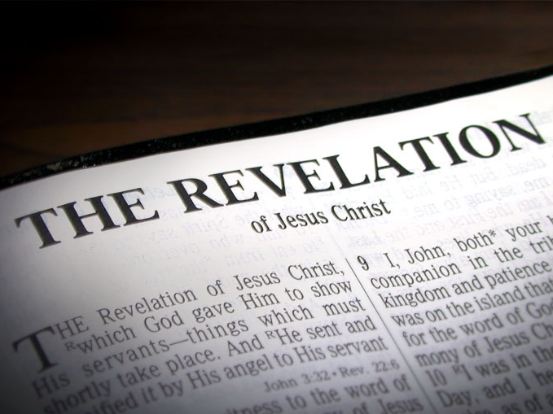
6. What else does the book of Revelation say about this amazing city?
Revelation 21:10-27
(1824)

Slide 16
a) It has the glory of God.

Slide 17
b) The wall is made of Jasper and is 144 cubits high.
vs.12, 17, 18

Slide 18
c) It has twelve gates three on each side. The gates are made of pearl.
vs.12, 13, 21

Slide 19
d) The city has twelve foundations each made of a precious stone.
vs.19

Slide 20
e) The streets are made of pure gold.
vs.21

Slide 21
f) No need of sun or moon.
vs.23

Slide 22
g) There shall be no night there.
vs.25

Slide 23
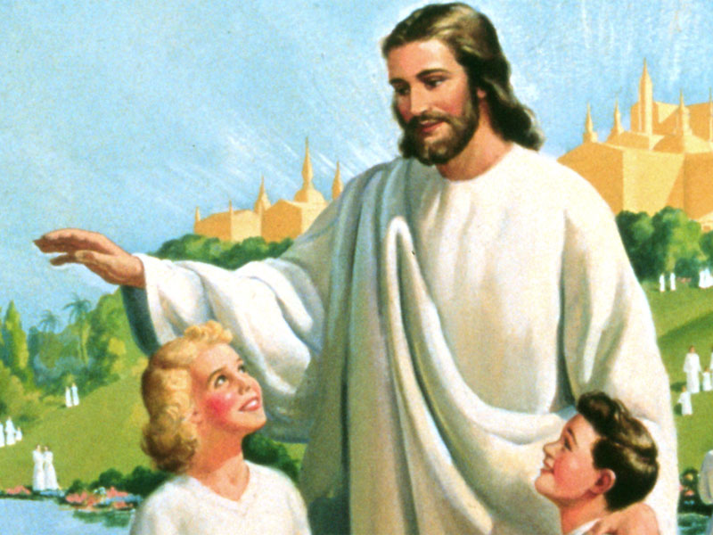
7. What is the source of the city water supply?
Revelation 22:1 (1825)

Slide 24
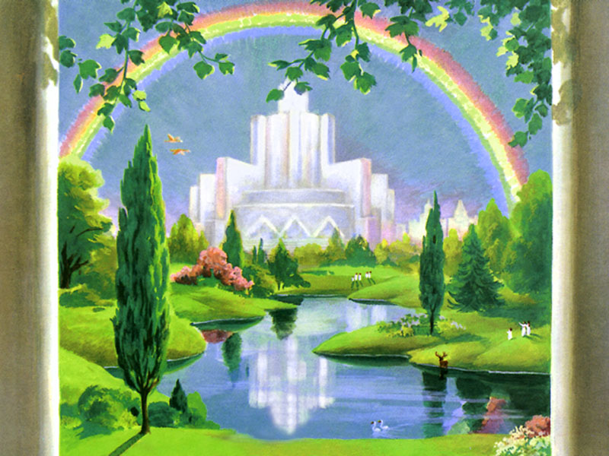
The river of water of life flows out of God’s throne.

Slide 25
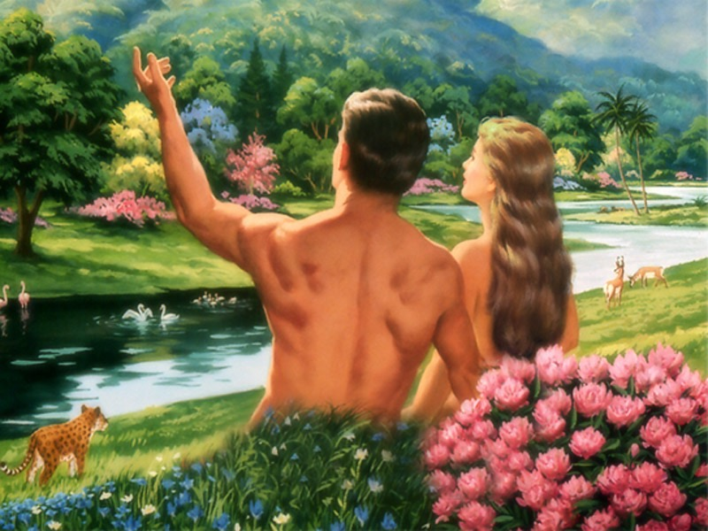
8. What miraculous tree, which Adam and Eve ate before sinning, will be restored in the Holy City?
Genesis 3:24 (5)
Revelation 22:2 (1825)

Slide 26
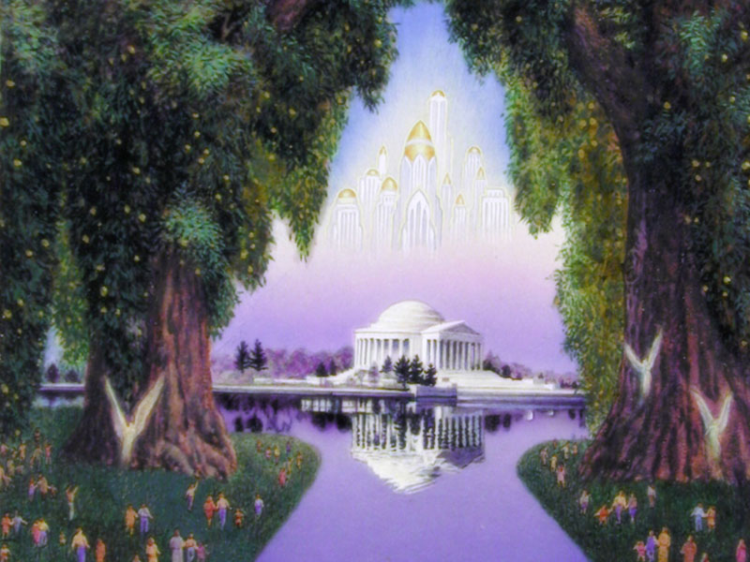
The Tree of Life

Slide 27
9. The Tree of Life bears twelve kinds of fruit, and yields a crop monthly. What purpose does this tree serve?
Revelation 22:2 (1825)
Genesis 3:22 (5)

Slide 28
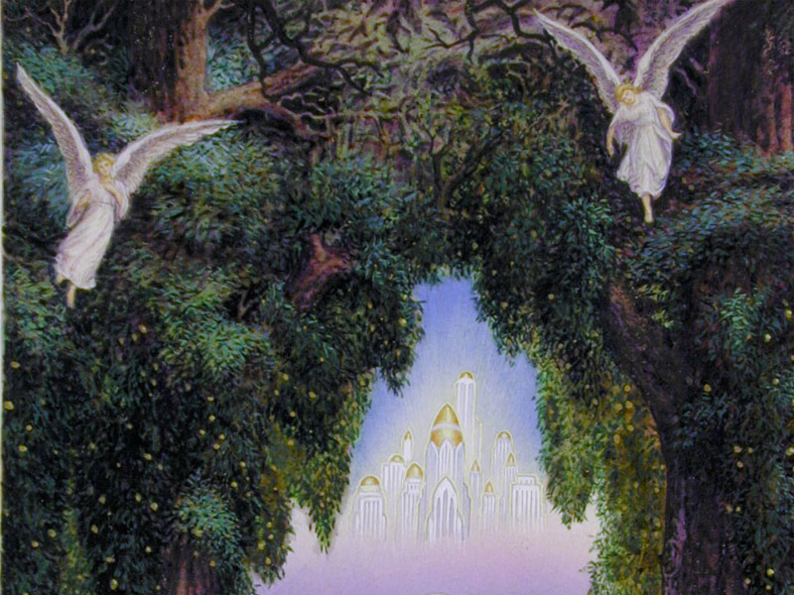
a. The leaves are for the healing of the nations.

Slide 29
b. Lest he… take… of the tree of life and eat and live forever.

Slide 30
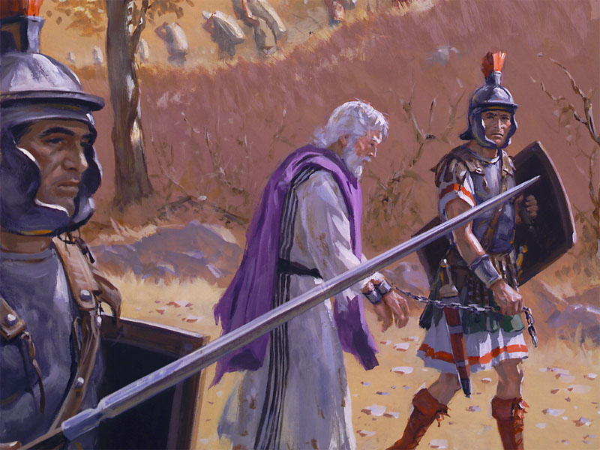
10. How do the things which God is preparing for us compare with the sufferings which we must
pass through here on earth?
Romans 8:18 (1657)

Slide 31
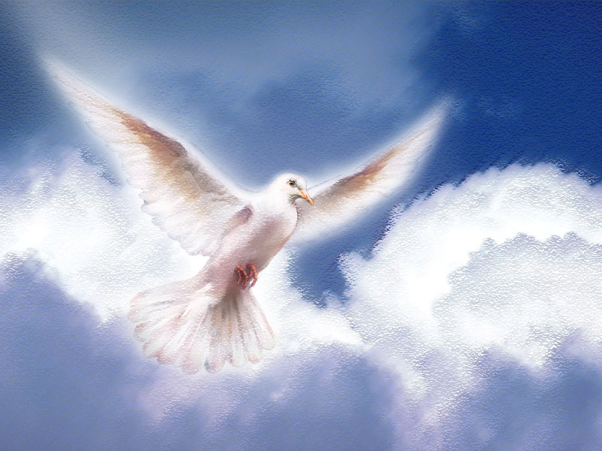
Not worthy to be compared.

Slide 32
OUR NEW
WORLD

Slide 33
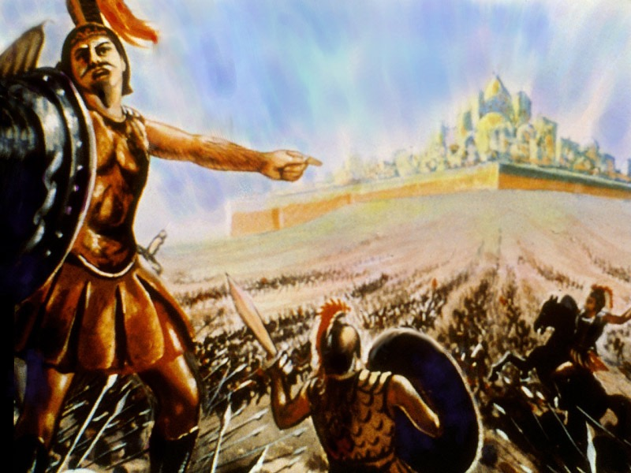
11. In lesson 7 we learned that when the Holy City descends to earth at the close of the 1000 years of Revelation 20, the wicked will be raised and Satan will lead them in an attempt to capture the Holy City. What happens to them?
Revelation 20:9 (1823)

Slide 34
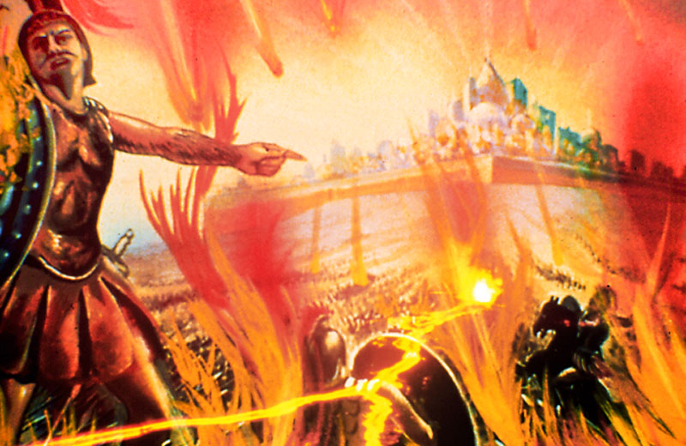
They are devoured by fire.

Slide 35
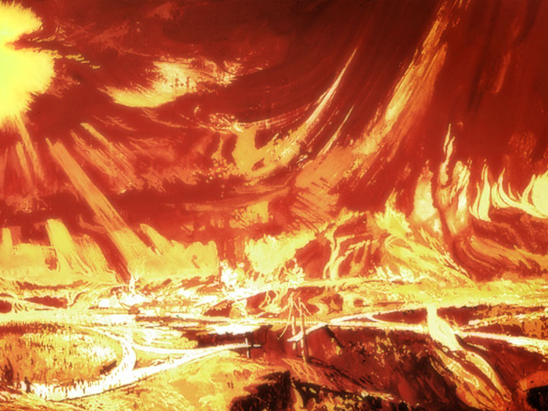
12. What else does the fire accomplish in addition to devouring Satan, his angels and the wicked?
2 Peter 3:10 (1789)

Slide 36
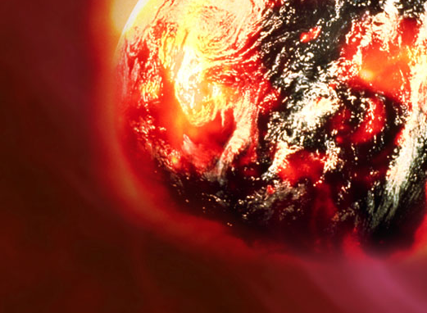
The elements shall melt with fervent heat, the earth also and the works that are therein shall be burned up.

Slide 37
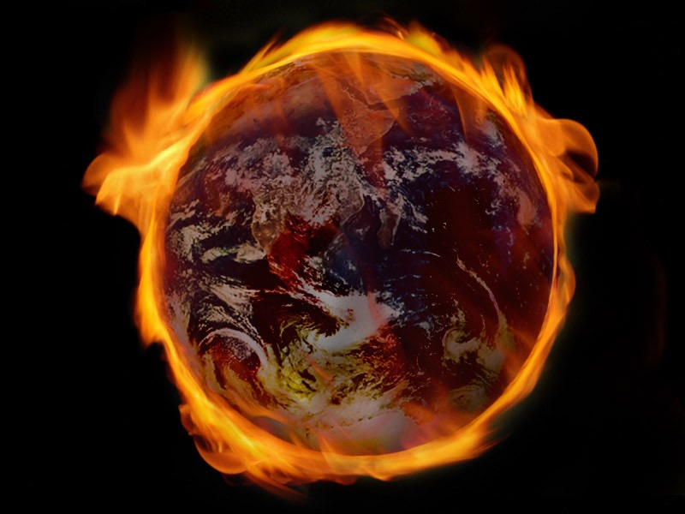
13. What does God next do?
Revelation 21:1 (1823)
2 Peter 3:13 (1789)

Slide 38
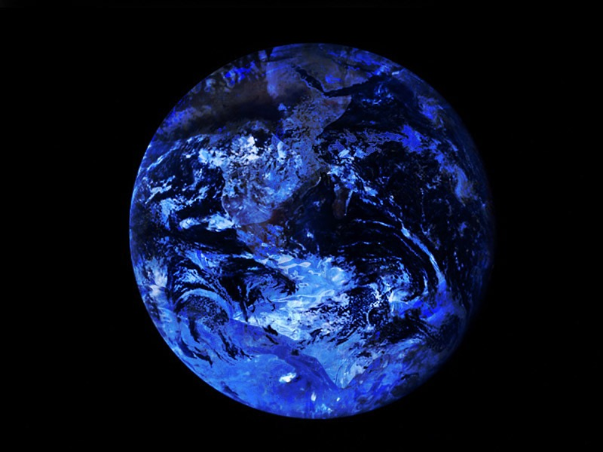
He creates new heavens and a new earth wherein dwells righteousness.

Slide 39
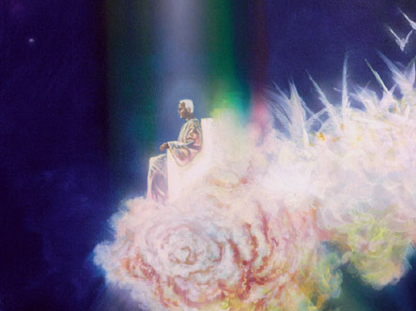
14. Where will God live after the Holy City becomes the capital of the earth made new?
Revelation 21:3 (1823)

Slide 40
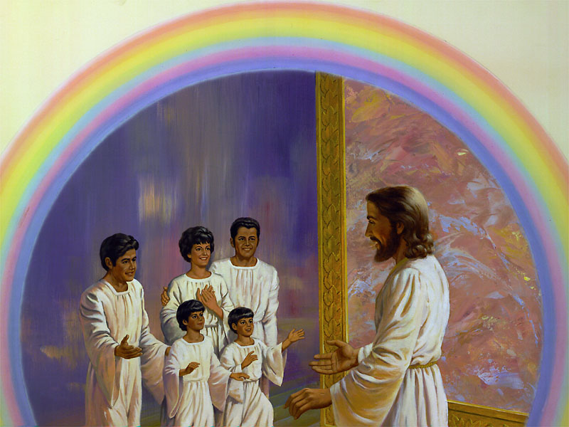
Here on earth with His people.

Slide 41
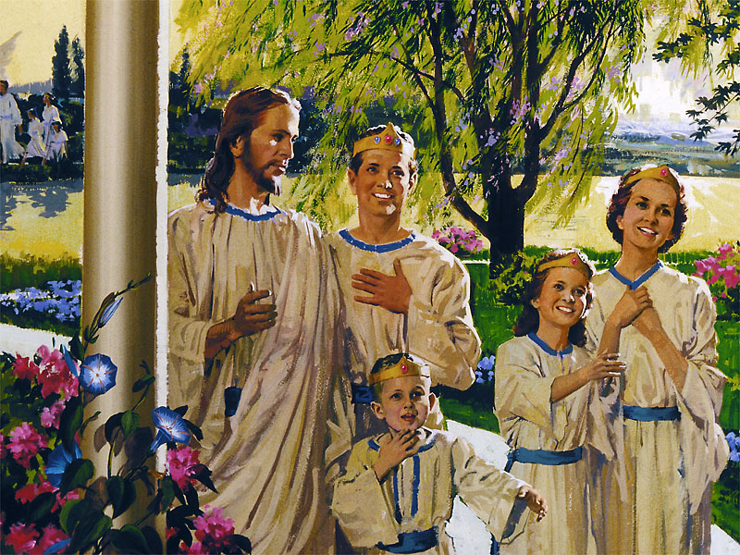
15. Everyone will have a fabulous home in the Holy City. Who builds this home?
John 14:2, 3 (1575)

Slide 42
Jesus

Slide 43
REAL HEAVEN
REAL PEOPLE

Slide 44
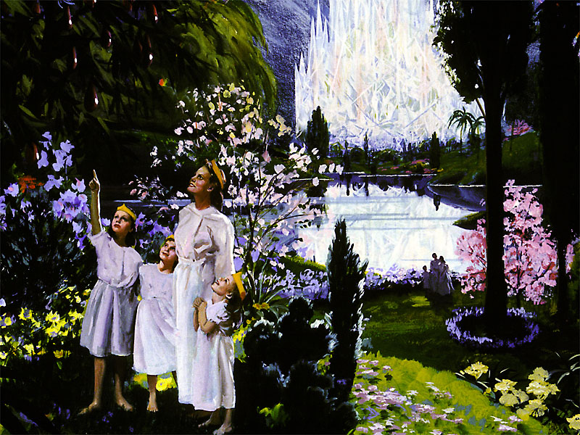
16. What kinds of bodies will the people who enter God’s Kingdom have?
Philippians 3:20, 21 (1725)

Slide 45
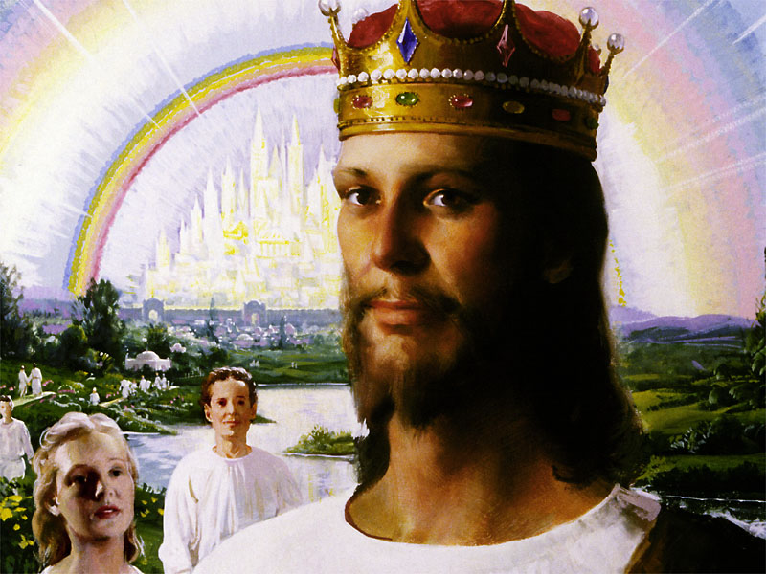
Bodies like Jesus

Slide 46
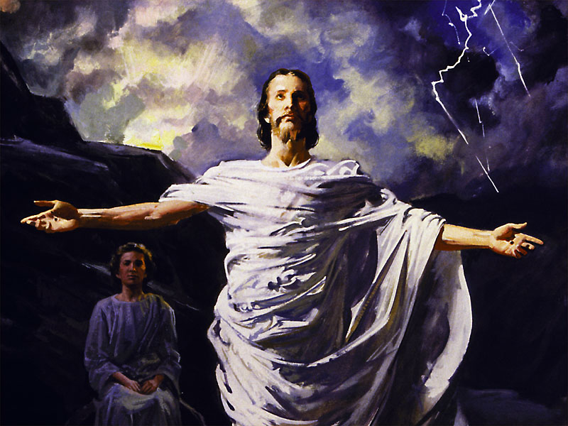
17. After Jesus’ resurrection what kind of body did He have?
Luke 24:36-43 (1544)

Slide 47
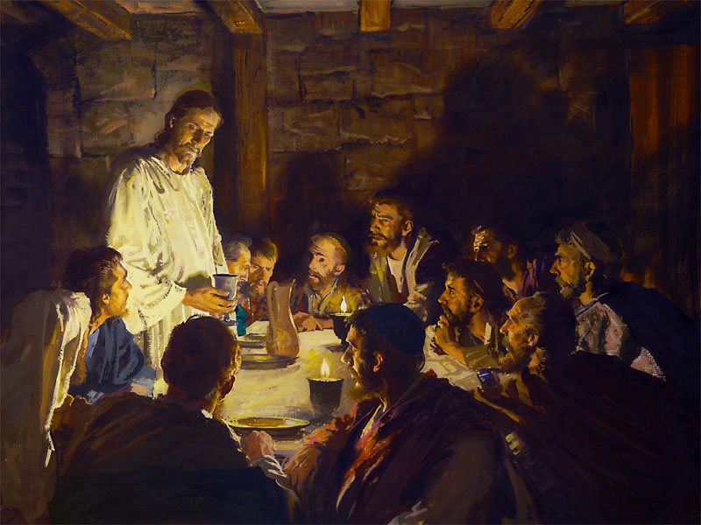
He had flesh and bones.

Slide 48
18. What will the saints do on the new earth, which demonstrates they are real and not ghosts?
Isaiah 65:17, 21, 22
(1103)

Slide 49
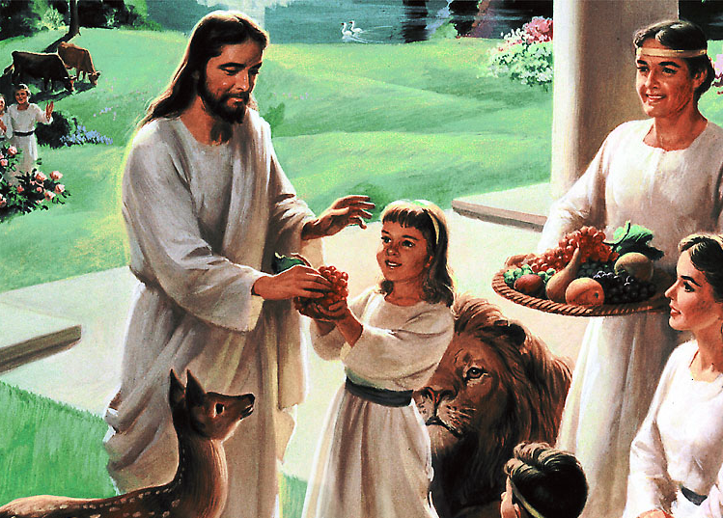
They shall build houses and inhabit them...

Slide 50
… and they shall plant vineyards and eat the fruit of them.

Slide 51
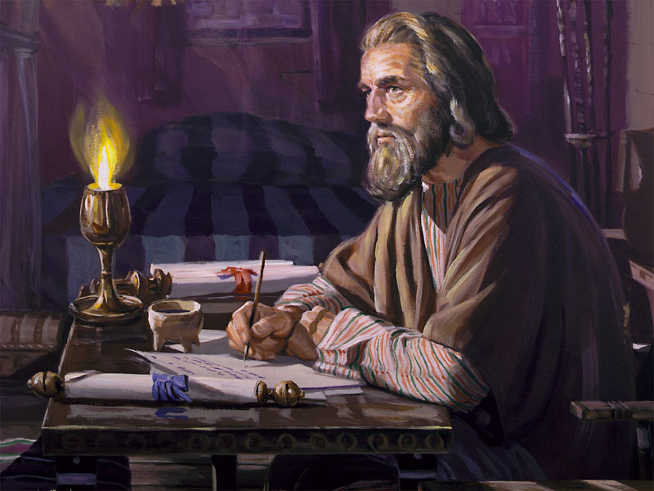
19. How does Paul describe the glories of God’s new Kingdom?
1 Corinthians 2:9 (1671)

Slide 52
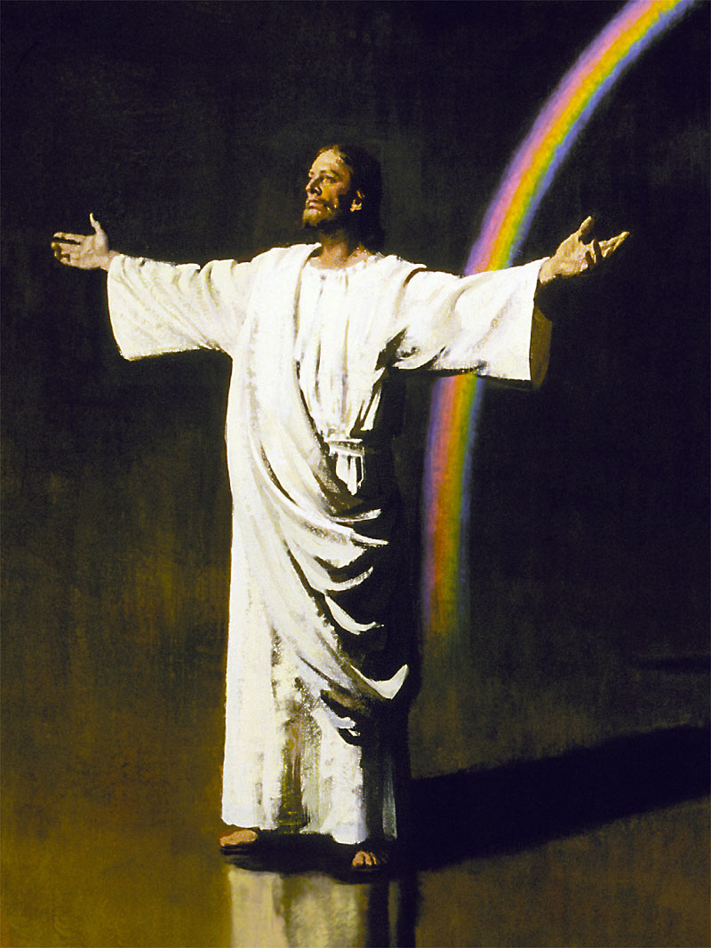
Eye hath not seen nor ear heard, neither have entered into the heart of man, the things which God hath prepared for them that love Him.

Slide 53
NO DISEASE
OR DEATH

Slide 54
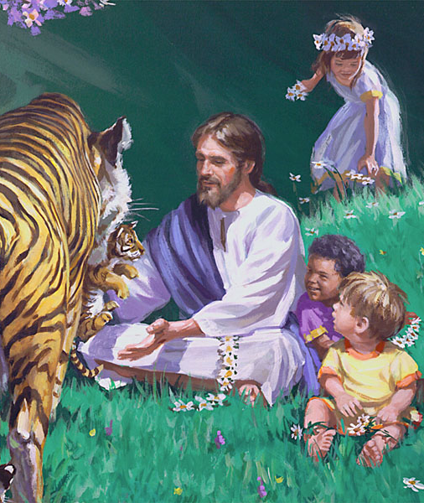
20. What comforting and exciting facts about Heaven are emphasized in the following …

Slide 55
… Scripture passages?
Isaiah 35:5, 6 (1064)
Revelation 21:4 (1823)
Isaiah 65:25 (1103)
Isaiah 11:6 (1037)

Slide 56
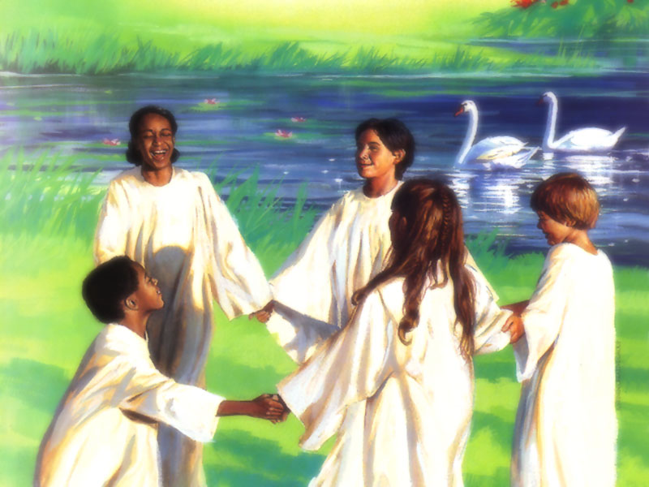
a. Eyes of the blind shall be opened.
Isaiah 35:5

Slide 57
b. Ears of the deaf shall be unstopped.
Isaiah 35:5

Slide 58
c. Lame man will leap as an hart.
Isaiah 35:6

Slide 59
d. Tongue of the dumb shall sing.
Isaiah 35:6

Slide 60
e. God will wipe away all tears.
Revelation 21:4

Slide 61
f. No more death, sorrow, crying or pain.
Revelation 21:4

Slide 62
g. Beasts will not hurt nor destroy.
Isaiah 65:25

Slide 63
h. The wolf, leopard and lion will be led by a little child.
Isaiah 11:6

Slide 64
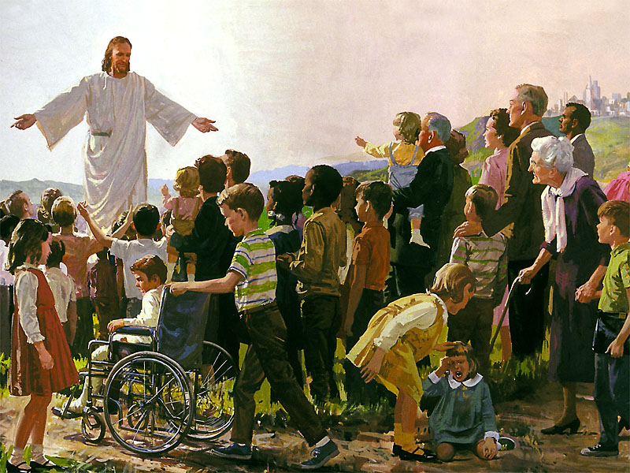
21. What promises has God given about Heaven that applies to the tragedies of this present earth? Isaiah 65:17 (1102)

Slide 65
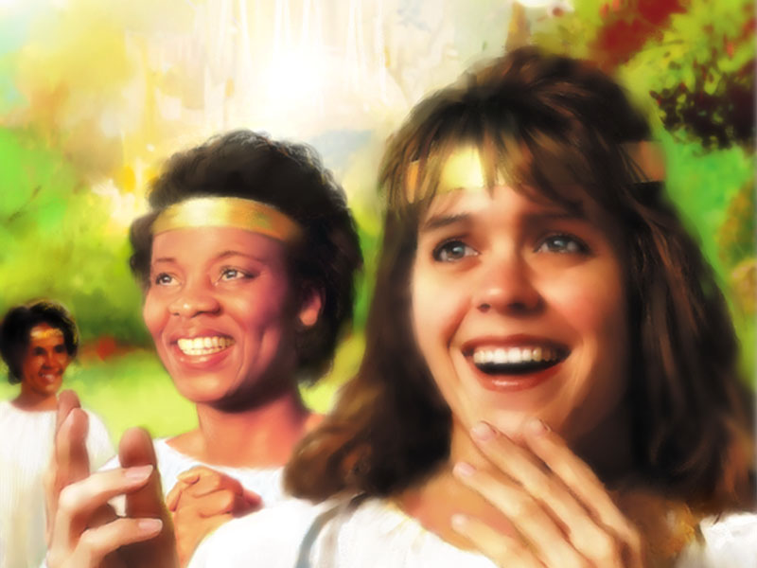
The former shall not be remembered nor come into mind.

Slide 66
ETERNAL
JOY AND
HEALTH

Slide 67
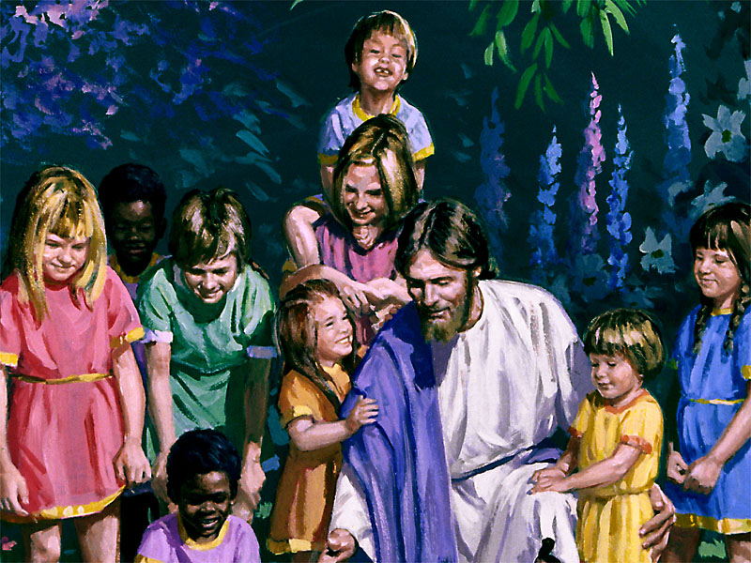
22. The prophet Isaiah gives us three more marvelous promises regarding the New Earth. What are they?
Isaiah 35:1 (1064)
Isaiah 33:24 (1062)
Isaiah 60:18 (1098)

Slide 68
a. The desert shall… blossom as a rose.

Slide 69
b. The inhabitant shall not say I am sick.

Slide 70
c. Violence shall no more be heard in the land.

Slide 71
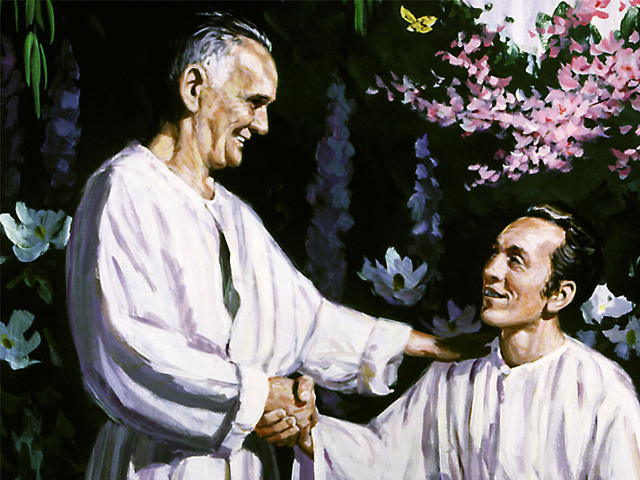
23. Will people recognize each other in heaven or will we lose identity?
1 Corinthians 13:12 (1684)

Slide 72
Then shall I know even as also I am known.

Slide 73
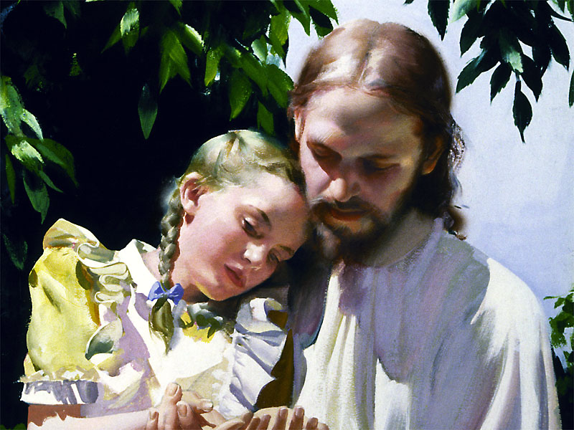
24. Eternity is a long time. Will people ever become bored in heaven?
Psalm 16:11 (867)

Slide 74
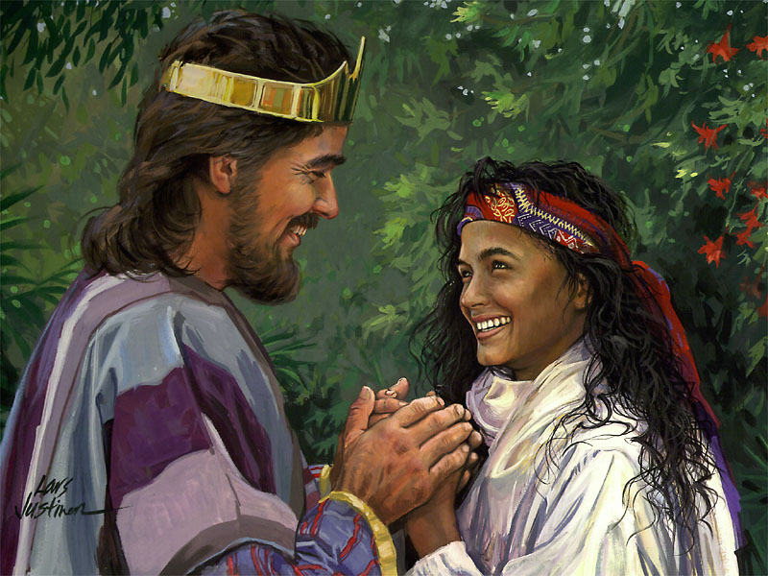
In thy presence is fullness of joy.

Slide 75
There are pleasures for evermore.

Slide 76
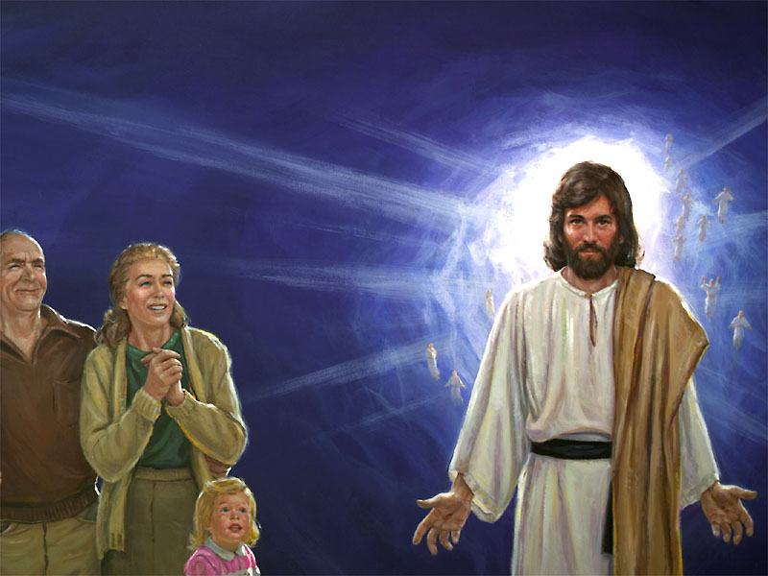
25. Who will the redeemed be like and who will be their constant companion?
1 John 3:2 (1792)
Revelation 14:4 (1815)

Slide 77
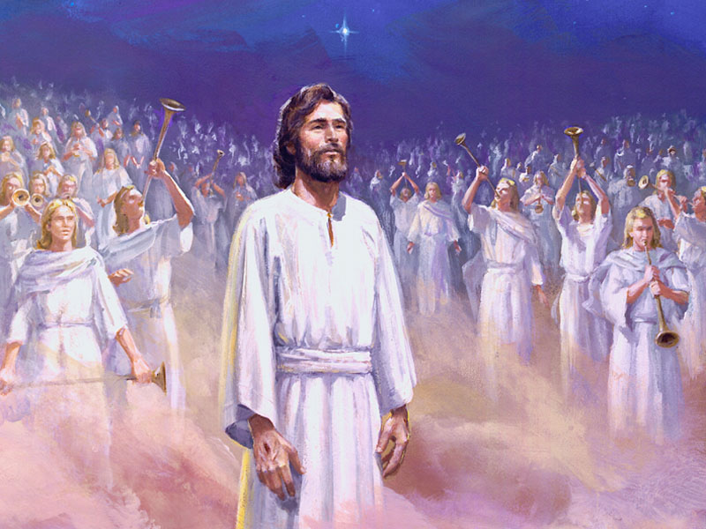
a. We shall be like Him.

Slide 78
b. These… follow the Lamb whithersoever He goeth.

Slide 79
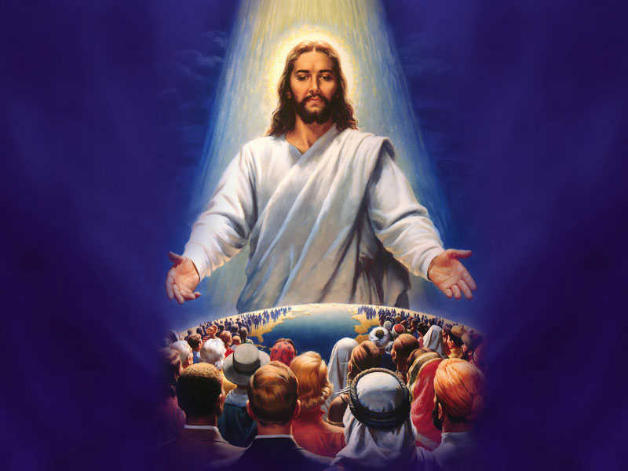
26. Sin is one thing that can keep me out of God’s
kingdom.
What can be
done about it?
1 John 7, 8 (1790)
Revelation 1:5 (1800)

Slide 80
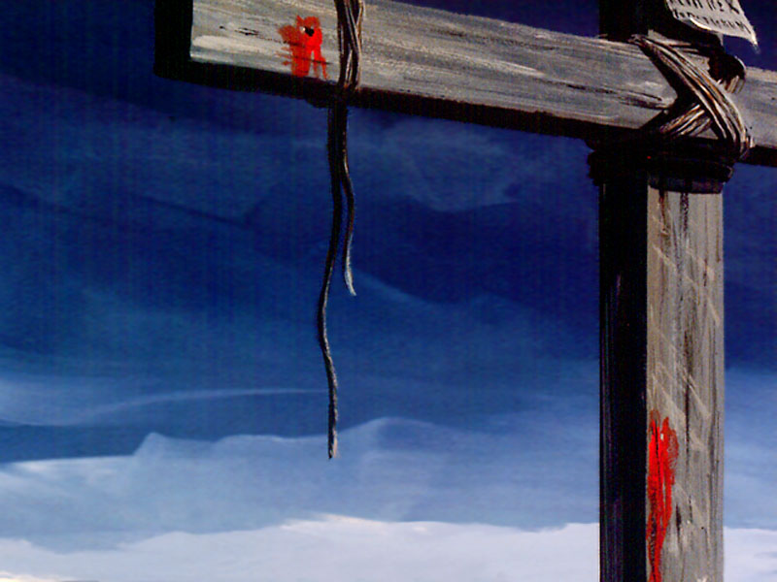
The blood of Jesus Christ His Son cleanseth us from all sins.

Slide 81
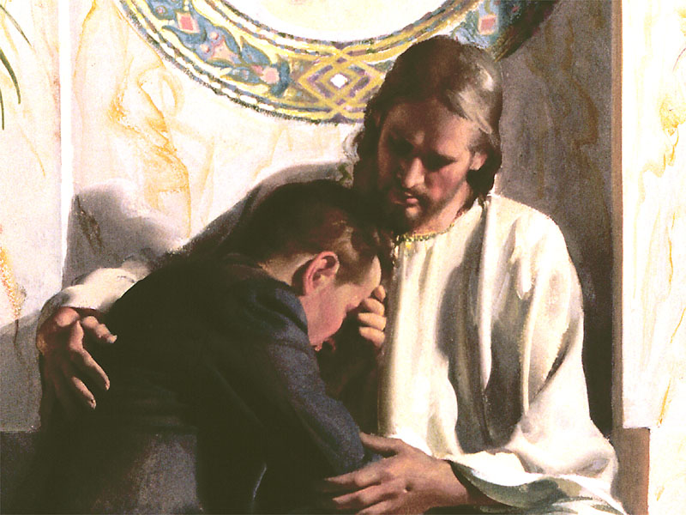
27. Jesus will freely and lovingly cleanse you if you request it. Will you ask Him for cleansing right now?

Slide 82
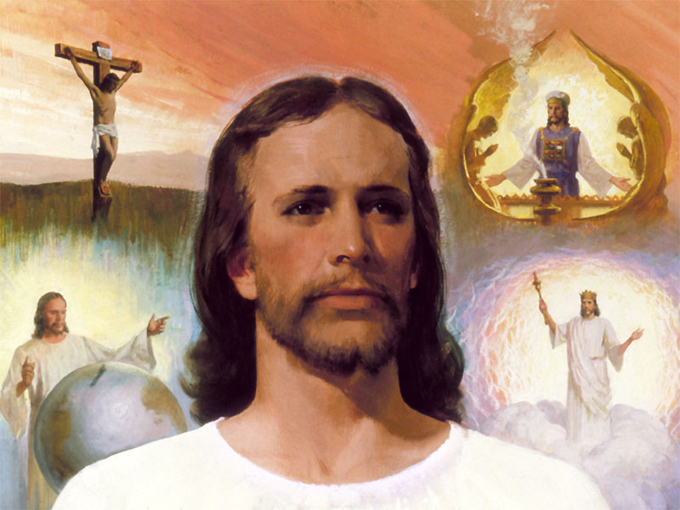

Slide 83
QUIZ QUESTIONS
(true or false)
1. The name of the glorious city that God made for the redeemed, that will travel through space, is the New Jerusalem.

Slide 84
QUIZ QUESTIONS
(true or false)
2. The streets of that city are made of gold.

Slide 85
QUIZ QUESTIONS
(true or false)
3. The wicked are destroyed when they try to take the city according to Revelation 20.

Slide 86
QUIZ QUESTIONS
(true or false)
4. God promises that the tragedies of this present world will not come into the minds of the redeemed after sin is eliminated.

Slide 87
QUIZ QUESTIONS
(true or false)
5. Eternity is a long time and there is the possibility that some might get bored.

Slide 88
QUIZ QUESTIONS
TRUE
1. The name of the glorious city that God made for the redeemed, that will travel through space, is the New Jerusalem.

Slide 89
QUIZ QUESTIONS
TRUE
2. The streets of that city are made of gold.

Slide 90
QUIZ QUESTIONS
TRUE
3. The wicked are destroyed when they try to take the city according to Revelation 20.

Slide 91
QUIZ QUESTIONS
TRUE
4. God promises that the tragedies of this present world will not come into the minds of the redeemed after sin is eliminated.

Slide 92
QUIZ QUESTIONS
FALSE
5. Eternity is a long time and there is the possibility that some might get bored.

Slide 93
RESPONSE QUESTIONS
1. If tonight’s Bible study brought joy to your heart, put an “X” in box #1.

Slide 94
RESPONSE QUESTIONS
2. If you want to thank Jesus for building your home in the New Jerusalem, so that you can be in His presence, not only now, but forever, put an “X” in box #2.

Slide 95
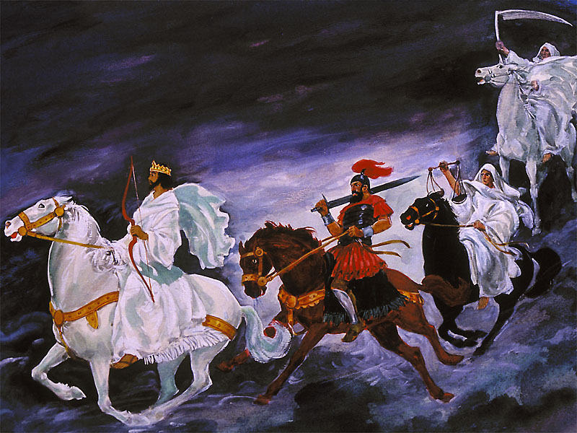
Our next lesson
Revelation Seminar
#9 The four horsemen of Revelation

